Slide 1

50.039 Theory and Practice of Deep Learning W1-S1 Introduction
Matthieu De Mari

Slide 2
About this week (Week 4)
XXX

Slide 3
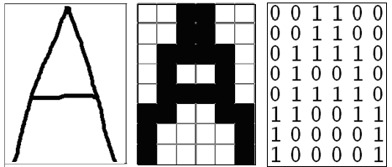
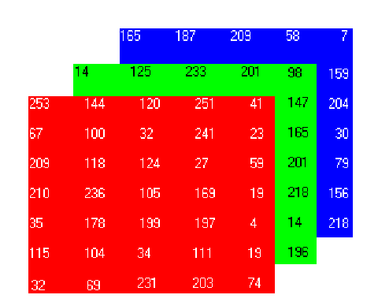
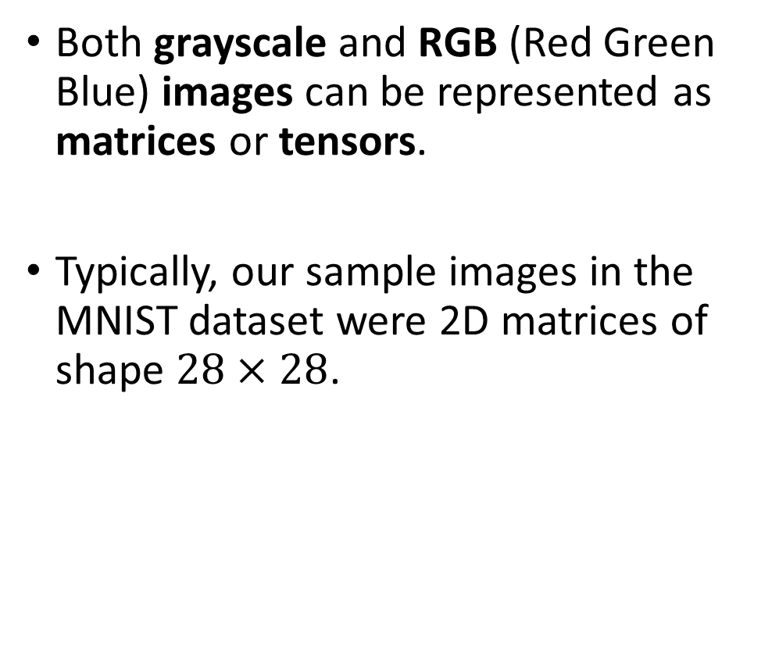
How to encode an image
Both grayscale and RGB (Red Green Blue) images can be represented as matrices or tensors.
Typically, our sample images in the MNIST dataset were 2D matrices of shape $28×28$.

Slide 4
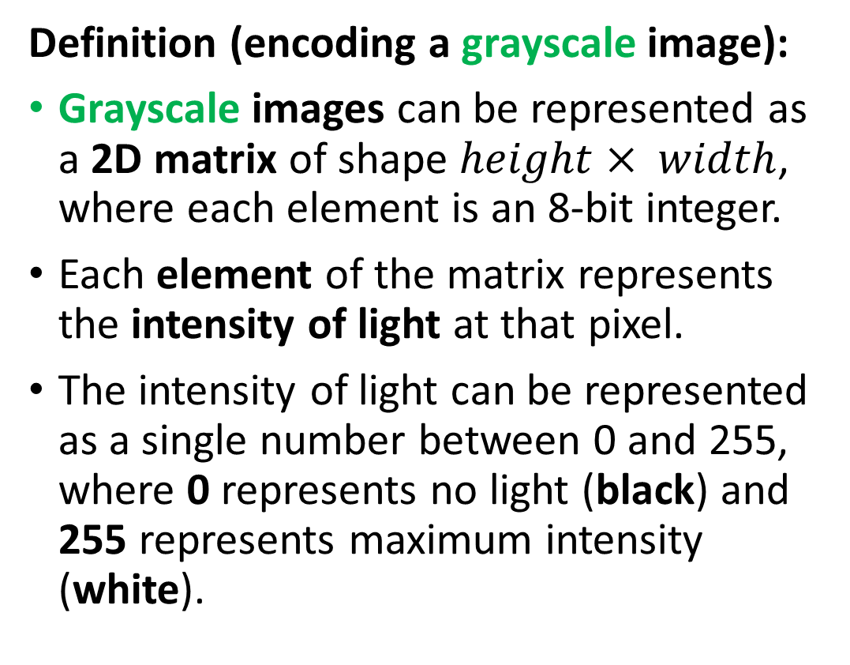
How to encode an image
Definition (encoding a grayscale image):
Grayscale images can be represented as a 2D matrix of shape $height× width$, where each element is an 8-bit integer.
Each element of the matrix represents the intensity of light at that pixel.
The intensity of light can be represented as a single number between 0 and 255, where 0 represents no light (black) and 255 represents maximum intensity (white).

Slide 5
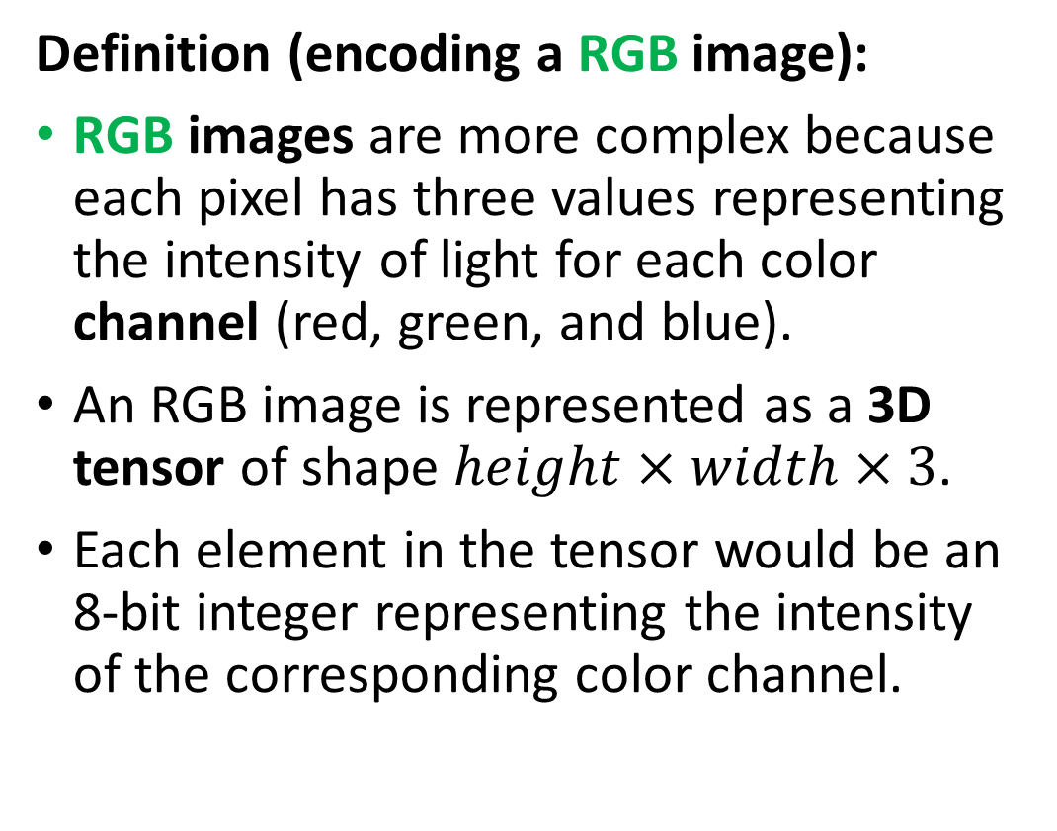
How to encode an image
Definition (encoding a RGB image):
RGB images are more complex because each pixel has three values representing the intensity of light for each color channel (red, green, and blue).
An RGB image is represented as a 3D tensor of shape $height×width×3$.
Each element in the tensor would be an 8-bit integer representing the intensity of the corresponding color channel.

Slide 6
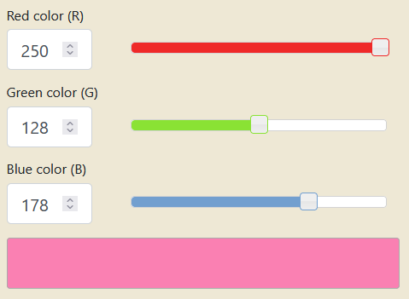
How to encode an image
Combining the red, green and blue values allows to generate any color. Try it!
https://www.rapidtables.com/convert/color/rgb-to-hex.html

Slide 7
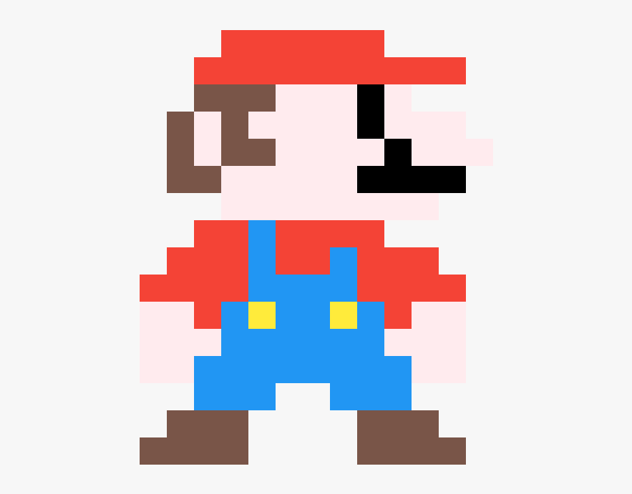
Pixels information
Each element in a Greyscale matrix or RGB matrix corresponds to a pixel, representing something in the image.
The problem, however, is that it is often impossible to guess the meaning of a given pixel, by looking at a pixel alone.

Slide 8
Pixels information
Can you guess what this pixel represents and what object it belongs to?
Flower petal
Piece of clothing
Skin of a human person
Feather of a bird

Slide 9
Pixels information
What if I show you some neighbouring pixels now?
Flower petal
Piece of clothing
Skin of a human person
Feather of a bird

Slide 10
Pixels information
What if I show you MORE neighbouring pixels now?
Flower petal
Piece of clothing
Skin of a human person
Feather of a bird

Slide 11
Pixels information
What if I show you MORE neighbouring pixels now?
Flower petal
Piece of clothing
Skin of a human person
Feather of a bird

Slide 12
The spatial dependence property
Definition (the spatial dependence property of pixels):
The spatial dependence property of pixels states that the meaning or interpretation of a single pixel in an image can often only be understood in the context of the pixels around it.
This is because the information in a single pixel is often not enough to describe the complete picture, or even just the pixel itself.
The relationship between the given pixel and its neighbouring pixels is necessary to provide a full understanding of this particular pixel, or even the image as a whole.
This is something we observed in the Mario pixel art example.

Slide 13
The homophily property
Definition (the homophily property of pixels):
Homophily in images refers to the phenomenon where pixels that are close to each other in space tend to have similar properties, such as color, texture, or intensity. In other words, is the tendency for similar pixels to be grouped together.
For example, in an image of a sky, pixels that are close to each other and have a similar blue color can often be grouped together and be considered part of the sky region.
This property is a key factor in image processing and computer vision algorithms, as it provides a way to segment images into meaningful regions and perform tasks like object recognition and image classification.

Slide 14
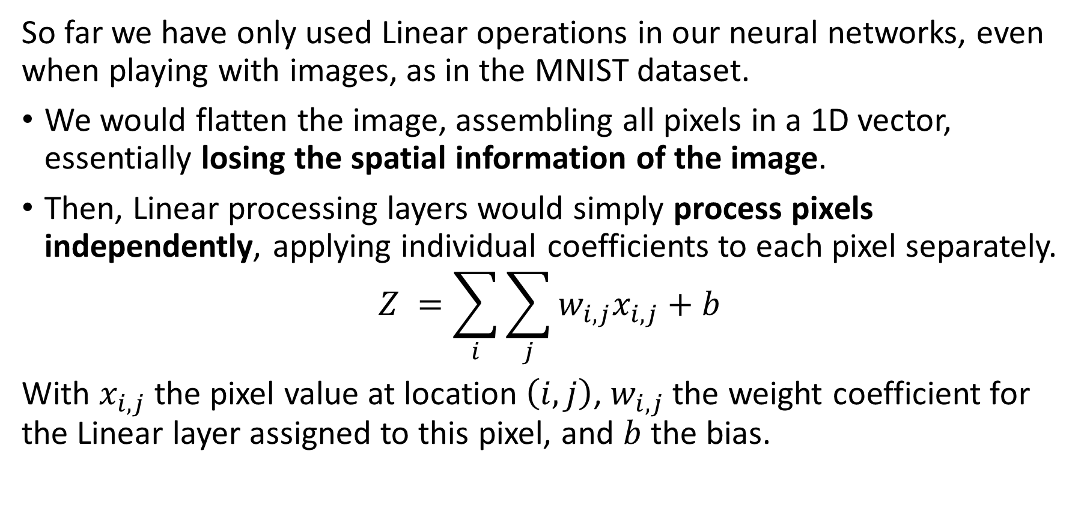
The problem with Linear processing
So far we have only used Linear operations in our neural networks, even when playing with images, as in the MNIST dataset.
We would flatten the image, assembling all pixels in a 1D vector, essentially losing the spatial information of the image.
Then, Linear processing layers would simply process pixels independently, applying individual coefficients to each pixel separately.
$$Z =\sum_{i}{\sum_{j}{w_{i,j}x_{i,j}+b}}$$
With $x_{i,j}$ the pixel value at location $\left(i,j\right)$, $w_{i,j}$ the weight coefficient for the Linear layer assigned to this pixel, and $b$ the bias.

Slide 15
The problem with Linear processing
Linear layers are not great at processing images because they do not take into account the spatial dependence of pixels.
Pixels in images are typically related to each other in a spatial manner, i.e. the meaning of a pixel depends on the neighbour pixels.
Unfortunately, linear models would assume each pixel is independent of the others and process them independently, which is not correct.
As a result, linear layers can miss important spatial relationships between pixels. This can, in turn, result in poor image representation and interpretation.
→ Need for a more specific processing operation for images, to use in place of the Linear one!

Slide 16
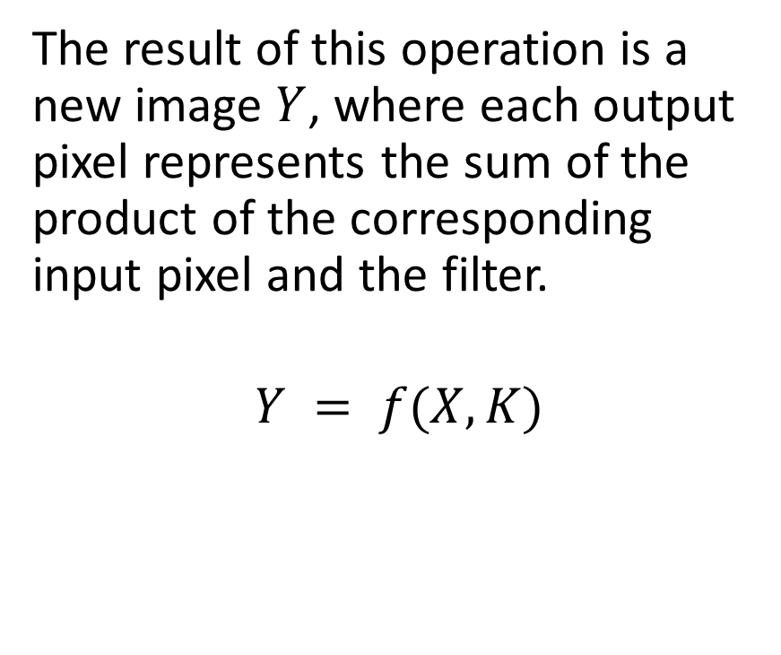
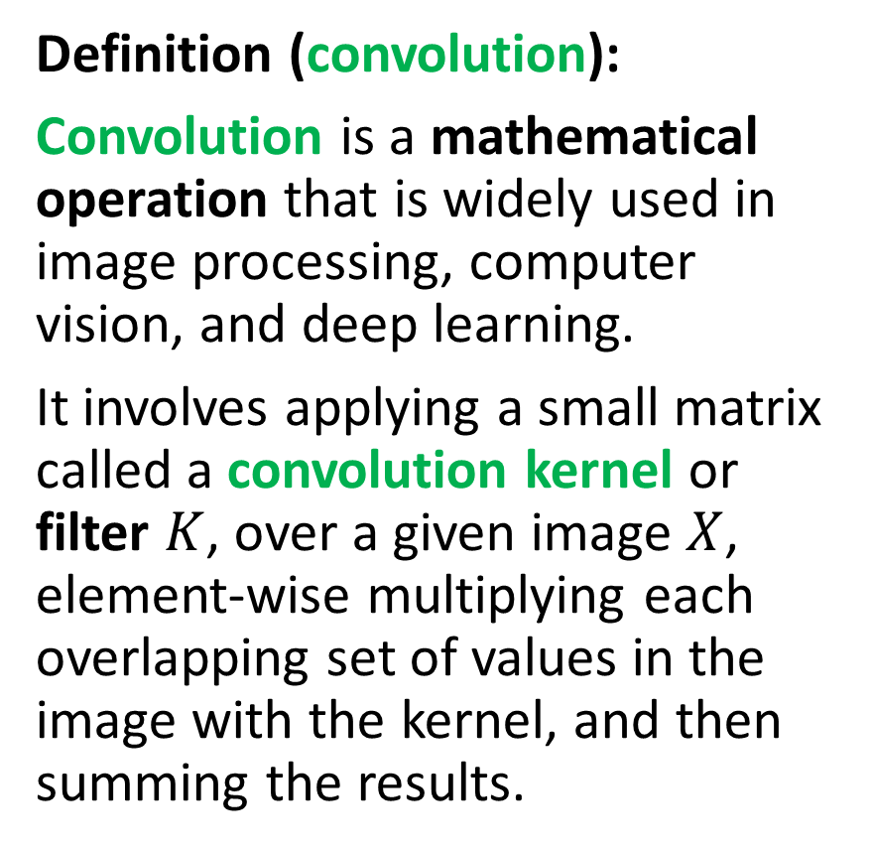
Introducing convolution!
Definition (convolution):
Convolution is a mathematical operation that is widely used in image processing, computer vision, and deep learning.
It involves applying a small matrix called a convolution kernel or filter $K$, over a given image $X$, element-wise multiplying each overlapping set of values in the image with the kernel, and then summing the results.
The result of this operation is a new image $Y$, where each output pixel represents the sum of the product of the corresponding input pixel and the filter.
$$Y = f(X, K)$$

Slide 17
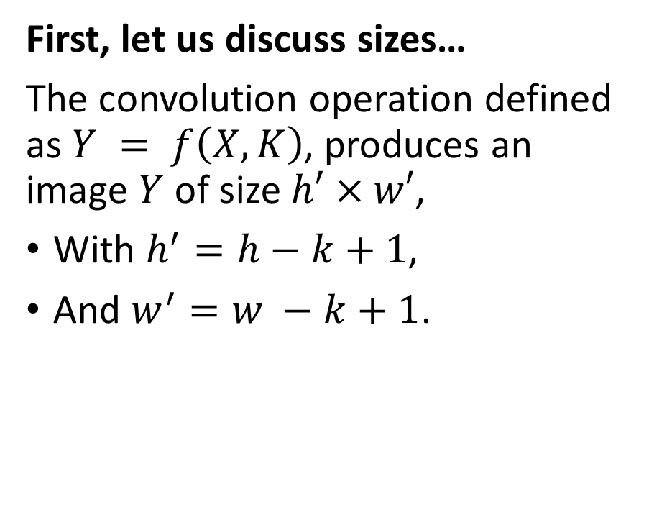
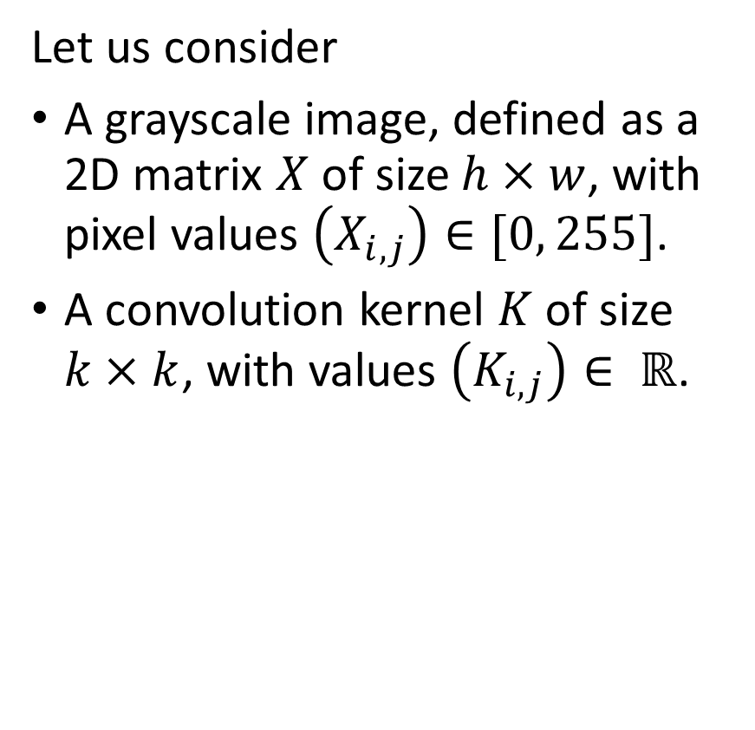
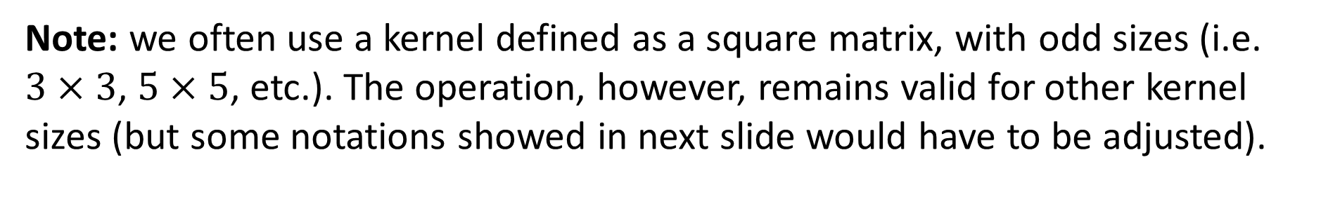
Introducing convolution!
Let us consider
A grayscale image, defined as a 2D matrix $X$ of size $h×w$, with pixel values $\left(X_{i,j}\right)∈[0, 255]$.
A convolution kernel $K$ of size $k×k$, with values $\left(K_{i,j}\right)∈ ℝ$.
First, let us discuss sizes…
The convolution operation defined as $Y = f\left(X, K\right)$, produces an image $Y$ of size $h′×w′$,
With $h^{′}=h−k+1$,
And $w^{′}=w −k+1$.
Note: we often use a kernel defined as a square matrix, with odd sizes (i.e. $3×3$, $5×5$, etc.). The operation, however, remains valid for other kernel sizes (but some notations showed in next slide would have to be adjusted).

Slide 18

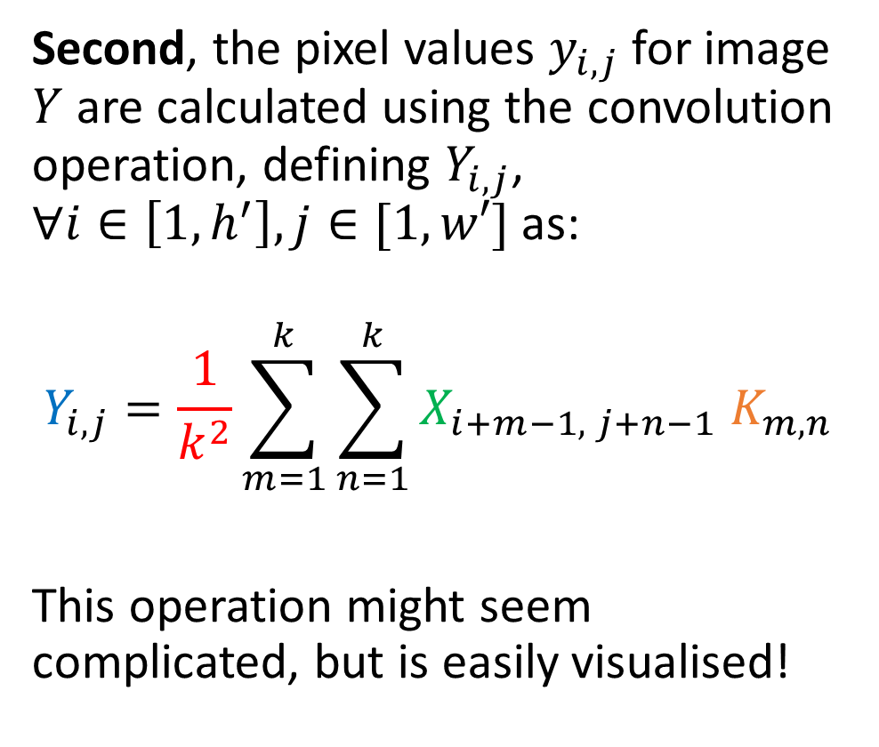


Introducing convolution!
1 | 2 | 4 | 2 | 1
4 | 7 | 3 | 2 | 1
4 | 5 | 2 | 3 | 1
2 | 1 | 7 | 8 | 4
3 | 2 | 4 | 7 | 8
X is 5 by 5
K is 3 by 3
Y is therefore 3 by 3.
(5-3+1 = 3)
$$X$$
Second, the pixel values $y_{i,j}$for image $Y$ are calculated using the convolution operation, defining $Y_{i,j}$, $∀i∈\left[1, h^{′}\right], j∈[1,w′]$ as:
$$Y_{i,j}=\frac{1}{k^{2}}\sum_{m=1}^{k}{\sum_{n=1}^{k}{X_{i+m−1, j+n−1} K_{m,n}}}$$
This operation might seem complicated, but is easily visualised!
1 | 0 | 1
0 | 2 | 1
1 | 0 | 1
$$K$$
… | … | …
… | … | …
… | … | …
$$Y$$

Slide 19

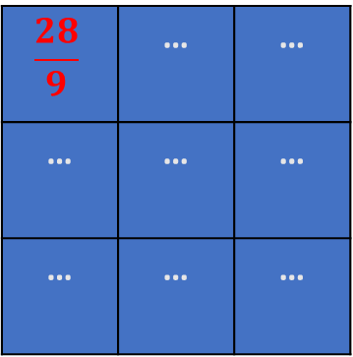
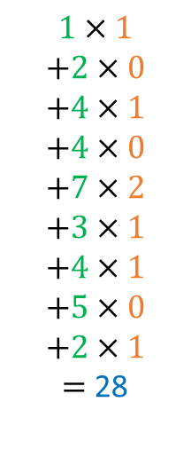
Introducing convolution!
1 | 2 | 4 | 2 | 1
4 | 7 | 3 | 2 | 1
4 | 5 | 2 | 3 | 1
2 | 1 | 7 | 8 | 4
3 | 2 | 4 | 7 | 8
$$1×1$$
$$+2×0$$
$$+4×1$$
$$+4×0$$
$$+7×2$$
$$+3×1$$
$$+4×1$$
$$+5×0$$
$$+2×1$$
$=$ 28
$$X$$
Second, the pixel values $y_{i,j}$for image $Y$ are calculated using the convolution operation, defining $Y_{i,j}$, $∀i∈\left[1, h^{′}\right], j∈[1,w′]$ as:
$$Y_{i,j}=\frac{1}{k^{2}}\sum_{m=1}^{k}{\sum_{n=1}^{k}{X_{i+m−1, j+n−1} K_{m,n}}}$$
This operation might seem complicated, but is easily visualised!
1 | 0 | 1
0 | 2 | 1
1 | 0 | 1
$$K$$
$$\frac{28}{9}$$ | … | …
… | … | …
… | … | …
$$Y$$

Slide 20
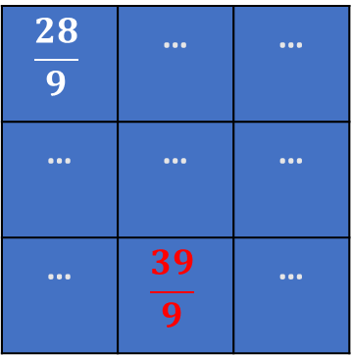
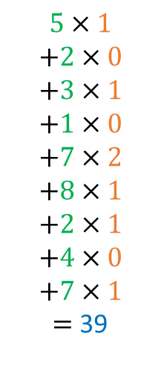
Introducing convolution!
1 | 2 | 4 | 2 | 1
4 | 7 | 3 | 2 | 1
4 | 5 | 2 | 3 | 1
2 | 1 | 7 | 8 | 4
3 | 2 | 4 | 7 | 8
$$5×1$$
$$+2×0$$
$$+3×1$$
$$+1×0$$
$$+7×2$$
$$+8×1$$
$$+2×1$$
$$+4×0$$
$$+7×1$$
$=$ 39
$$X$$
Second, the pixel values $y_{i,j}$for image $Y$ are calculated using the convolution operation, defining $Y_{i,j}$, $∀i∈\left[1, h^{′}\right], j∈[1,w′]$ as:
$$Y_{i,j}=\frac{1}{k^{2}}\sum_{m=1}^{k}{\sum_{n=1}^{k}{X_{i+m−1, j+n−1} K_{m,n}}}$$
This operation might seem complicated, but is easily visualised!
1 | 0 | 1
0 | 2 | 1
1 | 0 | 1
$$K$$
$$\frac{28}{9}$$ | … | …
… | … | …
… | $$\frac{39}{9}$$ | …
$$Y$$

Slide 21
Introducing convolution!
1 | 2 | 4 | 2 | 1
4 | 7 | 3 | 2 | 1
4 | 5 | 2 | 3 | 1
2 | 1 | 7 | 8 | 4
3 | 2 | 4 | 7 | 8
$$5×1$$
$$+2×0$$
$$+3×1$$
$$+1×0$$
$$+7×2$$
$$+8×1$$
$$+2×1$$
$$+4×0$$
$$+7×1$$
$=$ 39
$$X$$
1 | 0 | 1
0 | 2 | 1
1 | 0 | 1
$$K$$
$$\frac{28}{9}$$ | … | …
… | … | …
… | $$\frac{39}{9}$$ | …
$$Y$$

Slide 22

Introducing convolution!
1 | 2 | 4 | 2 | 1
4 | 7 | 3 | 2 | 1
4 | 5 | 2 | 3 | 1
2 | 1 | 7 | 8 | 4
3 | 2 | 4 | 7 | 8
$$5×1$$
$$+2×0$$
$$+3×1$$
$$+1×0$$
$$+7×2$$
$$+8×1$$
$$+2×1$$
$$+4×0$$
$$+7×1$$
$=$ 39
$$X$$
Second, the pixel values $y_{i,j}$for image $Y$ are calculated using the convolution operation, defining $Y_{i,j}$, $∀i∈\left[1, h^{′}\right], j∈[1,w′]$ as:
$$Y_{i,j}=\frac{1}{k^{2}}\sum_{m=1}^{k}{\sum_{n=1}^{k}{X_{i+m−1, j+n−1} K_{m,n}}}$$
1 | 0 | 1
0 | 2 | 1
1 | 0 | 1
$$K$$
$$\frac{28}{9}$$ | … | …
… | … | …
… | $$\frac{39}{9}$$ | …
$$Y$$
Note: Sometimes, the normalization term is removed and we may instead normalize the kernel (ensuring elements in kernel matrix sum up to 1), or not.

Slide 23
Introducing convolution!
1 | 2 | 4 | 2 | 1
4 | 7 | 3 | 2 | 1
4 | 5 | 2 | 3 | 1
2 | 1 | 7 | 8 | 4
3 | 2 | 4 | 7 | 8
$$5×1$$
$$+2×0$$
$$+3×1$$
$$+1×0$$
$$+7×2$$
$$+8×1$$
$$+2×1$$
$$+4×0$$
$$+7×1$$
$=$ 39
$$X$$
Second, the pixel values $y_{i,j}$for image $Y$ are calculated using the convolution operation, defining $Y_{i,j}$, $∀i∈\left[1, h^{′}\right], j∈[1,w′]$ as:
$$Y_{i,j}=\frac{1}{k^{2}}\sum_{m=1}^{k}{\sum_{n=1}^{k}{X_{i+m−1, j+n−1} K_{m,n}}}$$
1 | 0 | 1
0 | 2 | 1
1 | 0 | 1
$$K$$
$$\frac{28}{9}$$ | … | …
… | … | …
… | $$\frac{39}{9}$$ | …
$$Y$$
→ At the end of the day, convolution is just another type of matrix multiplication!

Slide 24
Convolution and Image Processing courses
Convolution is a key mathematical operation that is widely used in computer vision and image processing to modify the apply a wide range of transformations on an image (enhancing contrast, blurring, edge detection, Instagram filters, etc).
If Computer Vision is a direction that interests you, I would strongly advise to take a course on Image Processing (with implementations in OpenCV, Photoshop, etc.) during your continued learning.
For instance: https://www.udemy.com/course/digital-image-processing-from-ground-up-in-python/

Slide 25
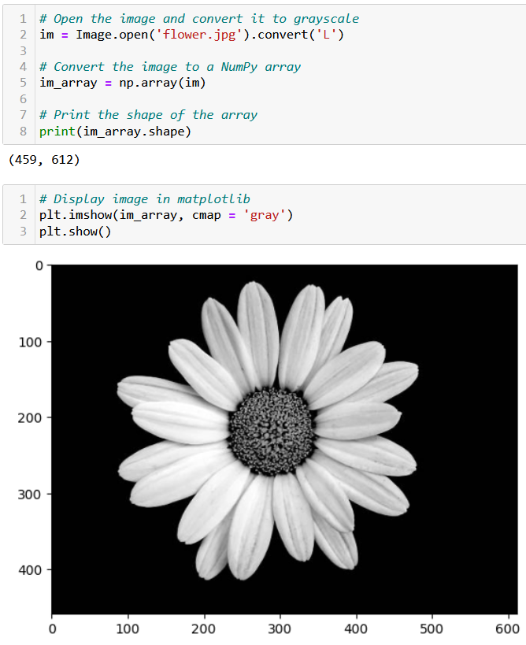
Testing convolution on images
Let us try the convolution operation on images to see their effect.
First, we need a greyscale image.

Slide 26
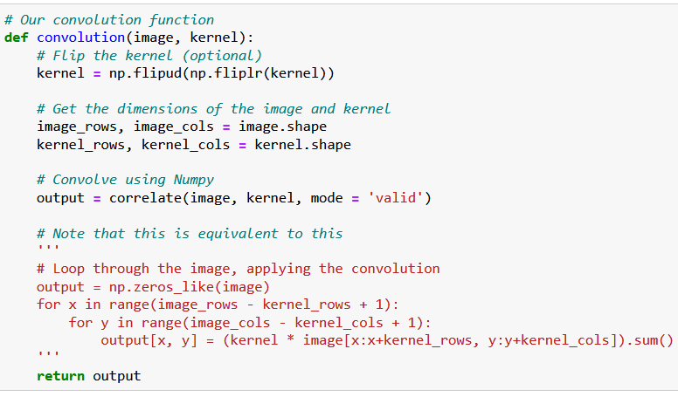
Testing convolution on images
Let us try the convolution operation on images to see their effect.
First, we need a greyscale image.
Second, we need a convolution function.

Slide 27
Testing convolution on images
Let us try the convolution operation on images to see their effect.
First, we need a greyscale image.
Second, we need a convolution function.
The magic for the transformation then happens when deciding on which kernel to use.

Slide 28
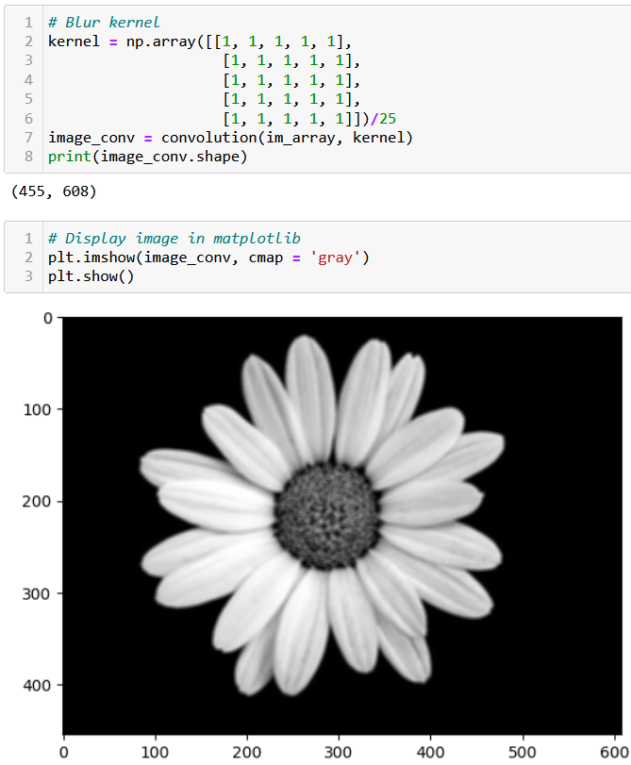
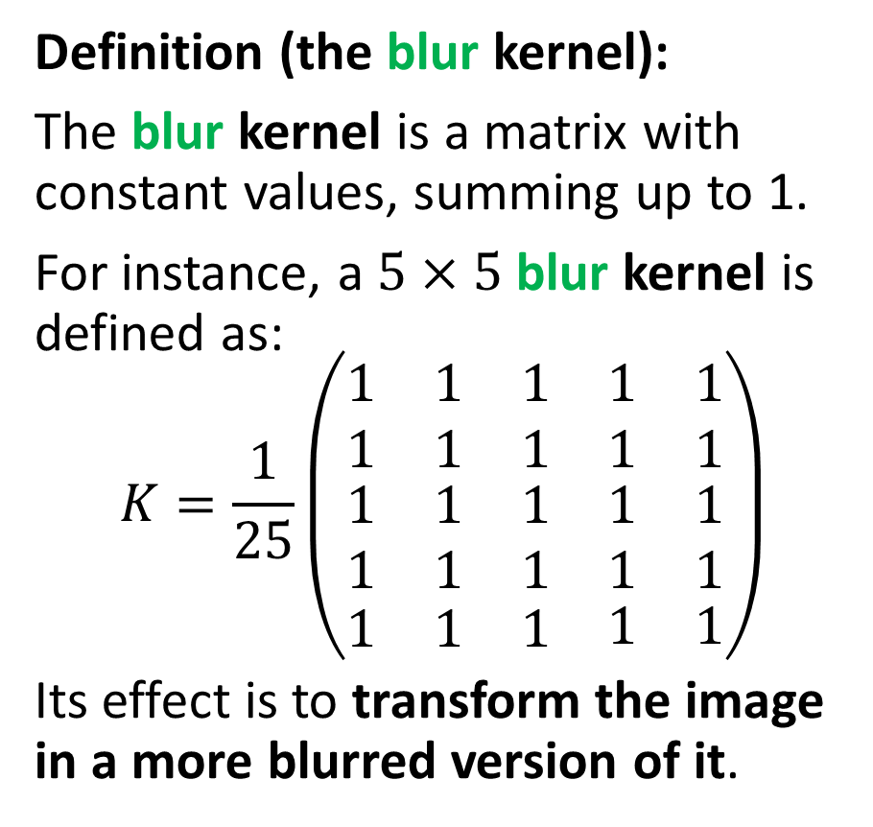
Testing convolution on images
Definition (the blur kernel):
The blur kernel is a matrix with constant values, summing up to 1.
For instance, a $5×5$ blur kernel is defined as:
$$K=\frac{1}{25}\left(\begin{matrix}\begin{matrix}1 & 1 & 1 \\ 1 & 1 & 1\end{matrix} & \begin{matrix}1 \\ 1\end{matrix} & \begin{matrix}1 \\ 1\end{matrix} \\ \begin{matrix}1 & 1 & 1 \\ 1 & 1 & 1\end{matrix} & \begin{matrix}1 \\ 1\end{matrix} & \begin{matrix}1 \\ 1\end{matrix} \\ \begin{matrix}1 & 1 & 1\end{matrix} & 1 & 1\end{matrix}\right)$$
Its effect is to transform the image in a more blurred version of it.

Slide 30
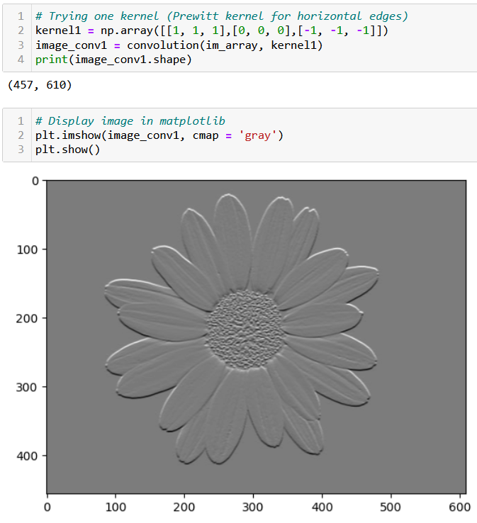
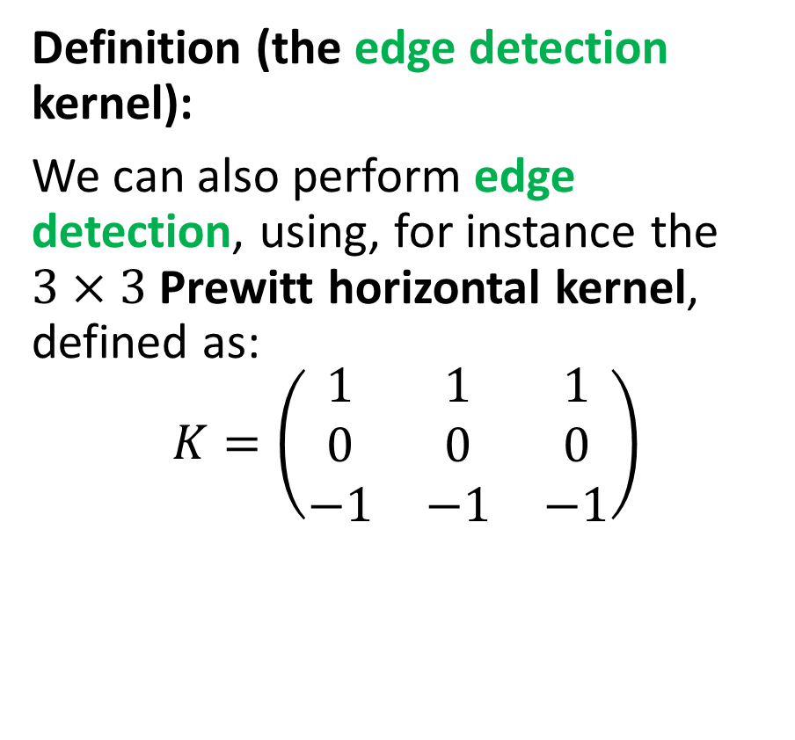
Testing convolution on images
Definition (the edge detection kernel):
We can also perform edge detection, using, for instance the $3×3$ Prewitt horizontal kernel, defined as:
$$K=\left(\begin{matrix}1 & 1 & 1 \\ 0 & 0 & 0 \\ −1 & −1 & −1\end{matrix}\right)$$

Slide 32
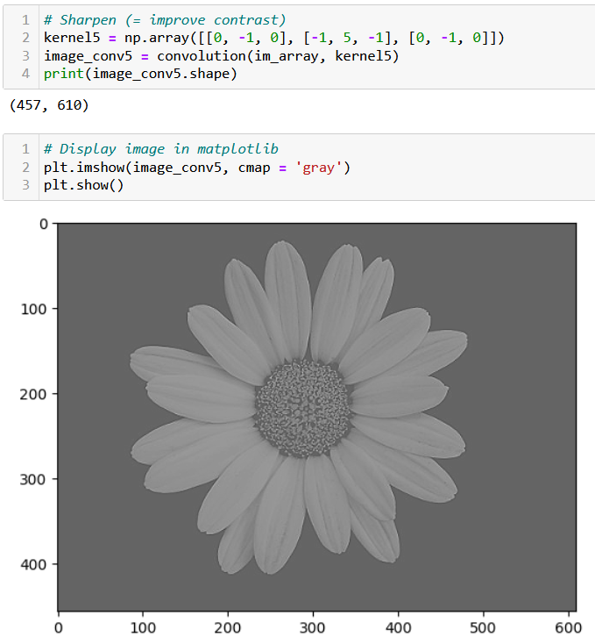
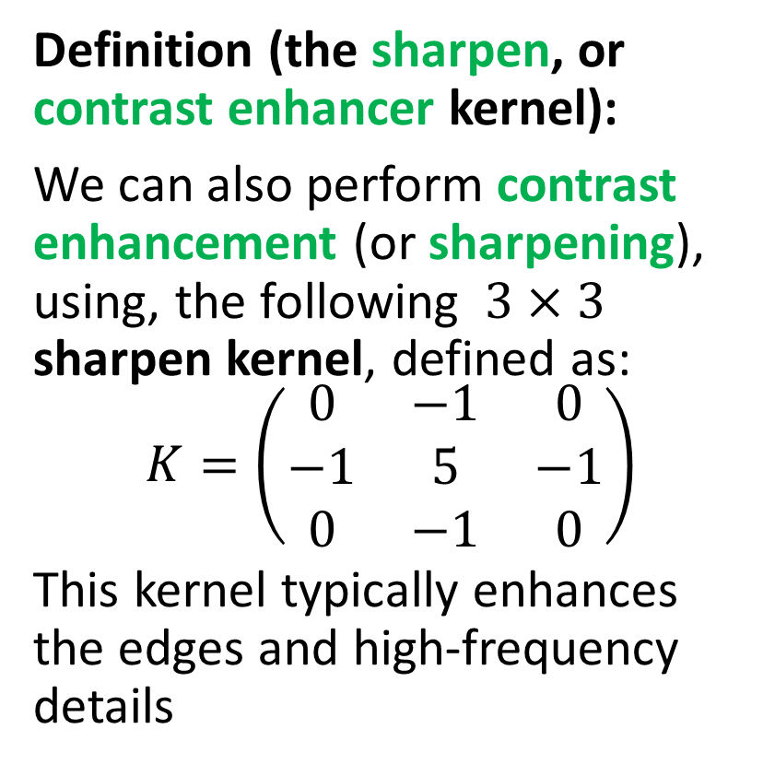
Testing convolution on images
Definition (the sharpen, or contrast enhancer kernel):
We can also perform contrast enhancement (or sharpening), using, the following $3×3$ sharpen kernel, defined as:
$$K=\left(\begin{matrix}0 & −1 & 0 \\ −1 & 5 & −1 \\ 0 & −1 & 0\end{matrix}\right)$$
This kernel typically enhances the edges and high-frequency details

Slide 34
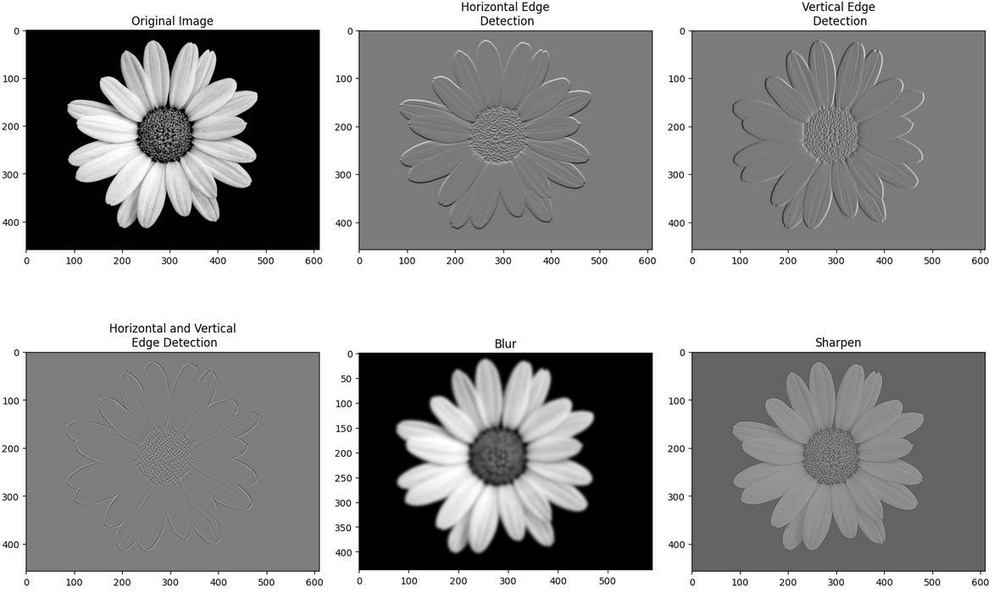
Many transformation kernels exist

Slide 35
Downsizing

Slide 36
Adding some padding

Slide 37
Adding a stride

Slide 39
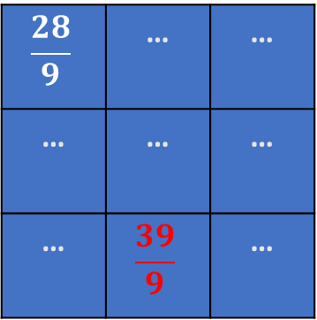
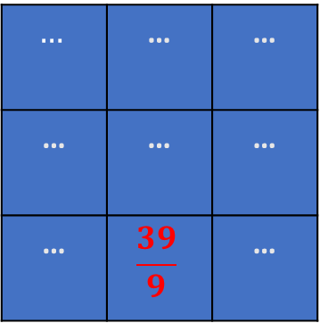
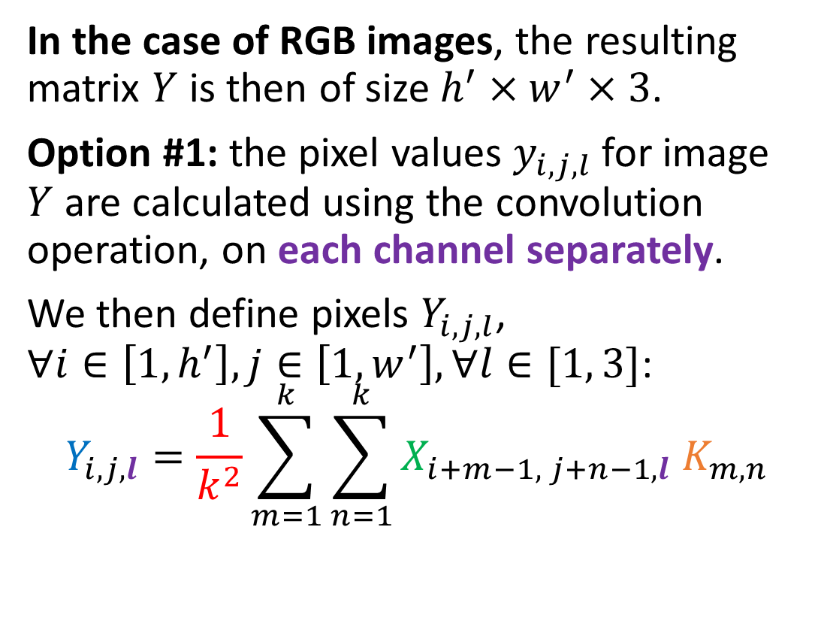

Convolution on high dim
1 | 2 | 4 | 2 | 1
4 | 7 | 3 | 2 | 1
4 | 5 | 2 | 3 | 1
2 | 1 | 7 | 8 | 4
3 | 2 | 4 | 7 | 8
$$5×1$$
$$+2×0$$
$$+3×1$$
$$+1×0$$
$$+7×2$$
$$+8×1$$
$$+2×1$$
$$+4×0$$
$$+7×1$$
$=$ 39
1 | 2 | 4 | 2 | 1
4 | 7 | 3 | 2 | 1
4 | 5 | 2 | 3 | 1
2 | 1 | 7 | 8 | 4
3 | 2 | 4 | 7 | 8
1 | 2 | 4 | 2 | 1
4 | 7 | 3 | 2 | 1
4 | 5 | 2 | 3 | 1
2 | 1 | 7 | 8 | 4
3 | 2 | 4 | 7 | 8
$$X$$
In the case of RGB images, the resulting matrix $Y$ is then of size $h^{′}×w^{′}×3$.
Option #1: the pixel values $y_{i,j, l}$for image $Y$ are calculated using the convolution operation, on each channel separately.
We then define pixels $Y_{i,j,l}$, $∀i∈\left[1, h^{′}\right], j∈\left[1,w^{′}\right], ∀l∈[1, 3]$:
$$Y_{i,j,l}=\frac{1}{k^{2}}\sum_{m=1}^{k}{\sum_{n=1}^{k}{X_{i+m−1, j+n−1,l} K_{m,n}}}$$
1 | 0 | 1
0 | 2 | 1
1 | 0 | 1
$$K$$
$$…$$ | … | …
… | … | …
… | $$\frac{39}{9}$$ | …
$$…$$ | … | …
… | … | …
… | $$\frac{39}{9}$$ | …
$$Y$$
$$\frac{28}{9}$$ | … | …
… | … | …
… | $$\frac{39}{9}$$ | …
This operation preserves the original number of channels of original image $X$, producing a new RGB image $Y$ as a result.

Slide 40
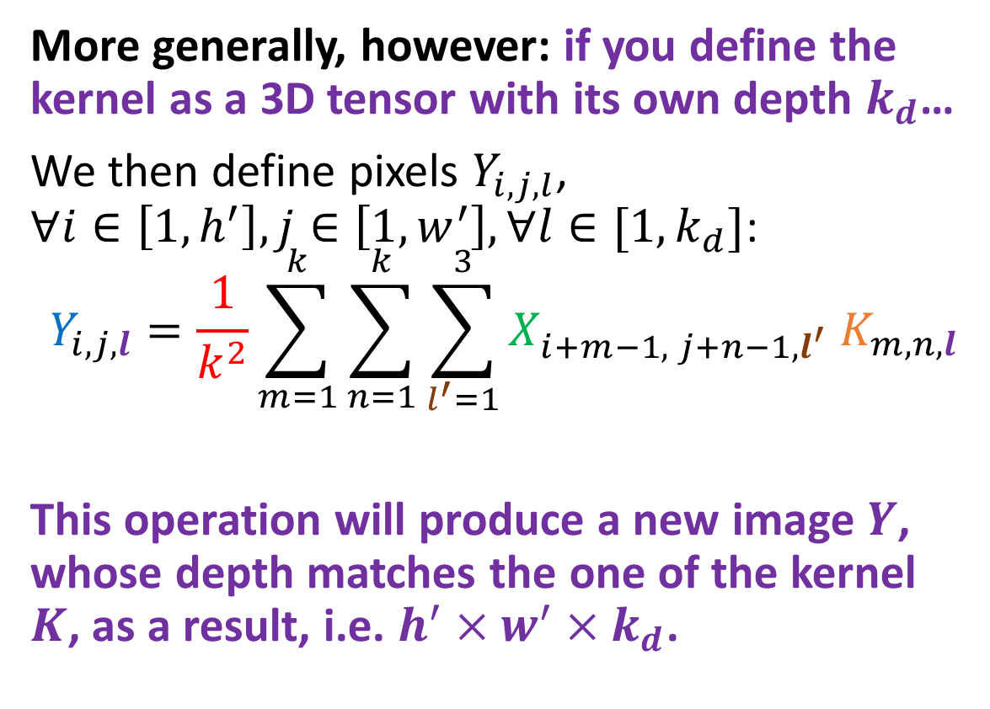
Convolution on high dim
1 | 2 | 4 | 2 | 1
4 | 7 | 3 | 2 | 1
4 | 5 | 2 | 3 | 1
2 | 1 | 7 | 8 | 4
3 | 2 | 4 | 7 | 8
$$5×1$$
$$+2×0$$
$$+3×1$$
$$+1×0$$
$$+7×2$$
$$+8×1$$
$$+2×1$$
$$+4×0$$
$$+7×1$$
$=$ 39
1 | 2 | 4 | 2 | 1
4 | 7 | 3 | 2 | 1
4 | 5 | 2 | 3 | 1
2 | 1 | 7 | 8 | 4
3 | 2 | 4 | 7 | 8
1 | 2 | 4 | 2 | 1
4 | 7 | 3 | 2 | 1
4 | 5 | 2 | 3 | 1
2 | 1 | 7 | 8 | 4
3 | 2 | 4 | 7 | 8
$$X$$
More generally, however: if you define the kernel as a 3D tensor with its own depth $k_{d}$…
We then define pixels $Y_{i,j,l}$, $∀i∈\left[1, h^{′}\right], j∈\left[1,w^{′}\right], ∀l∈[1, k_{d}]$:
$$Y_{i,j,l}=\frac{1}{k^{2}}\sum_{m=1}^{k}{\sum_{n=1}^{k}{\sum_{l^{′}=1}^{3}{X_{i+m−1, j+n−1,l^{′}} K_{m,n,l}}}}$$
This operation will produce a new image $Y$, whose depth matches the one of the kernel $K$, as a result, i.e. $h^{′}×w^{′}×k_{d}$.
1 | 0 | 1
0 | 2 | 1
1 | 0 | 1
1 | 0 | 1
0 | 2 | 1
1 | 0 | 1
$$K$$
1 | 0 | 1
0 | 2 | 1
1 | 0 | 1
$$…$$ | … | …
… | … | …
… | $$\frac{39}{9}$$ | …
$$…$$ | … | …
… | … | …
… | $$\frac{39}{9}$$ | …
$$Y$$
$$\frac{28}{9}$$ | … | …
… | … | …
… | $$\frac{39}{9}$$ | …

Slide 58
Conclusion (Week 4)
XXX
XXX

Slide 59
Learn more about these topics
Out of class, supporting papers, for those of you who are curious.
[XXX] XXX

Slide 60
Learn more about these topics
Some extra (easy) reading and videos for those of you who are curious.
[XXX] XXX

